Slide 1
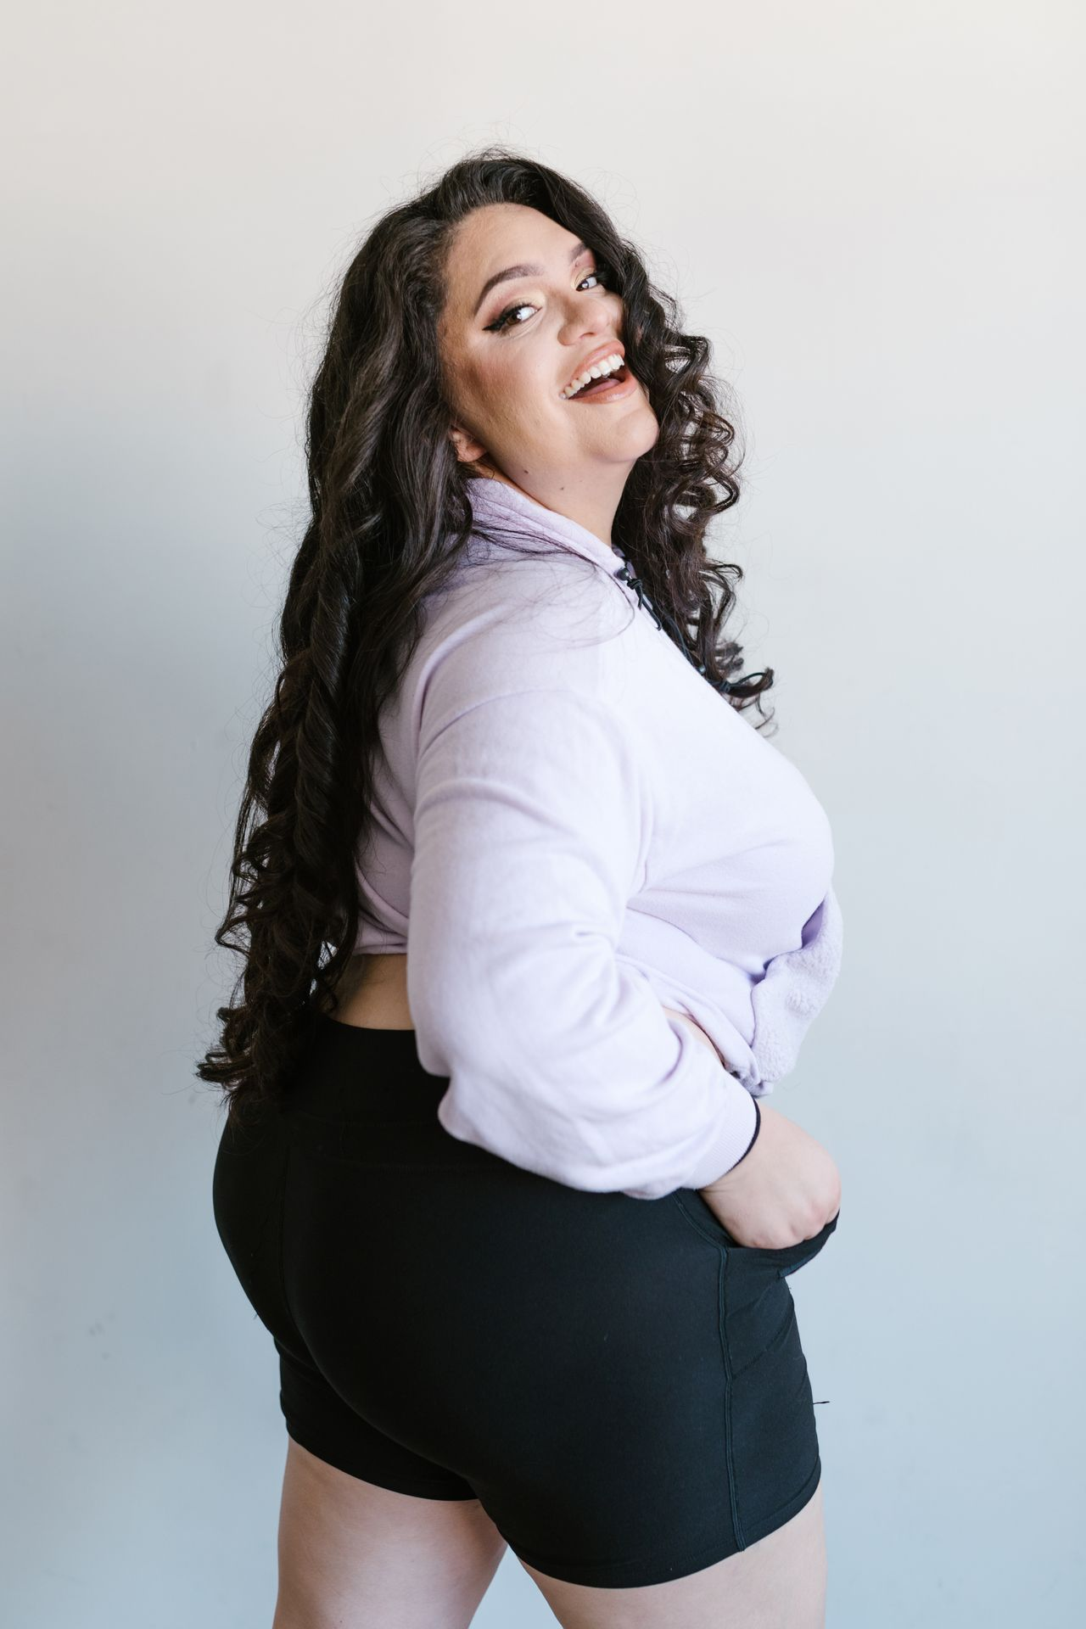
Every Body
Is Amazing
Grades 4–6
Together For Health

Slide 2
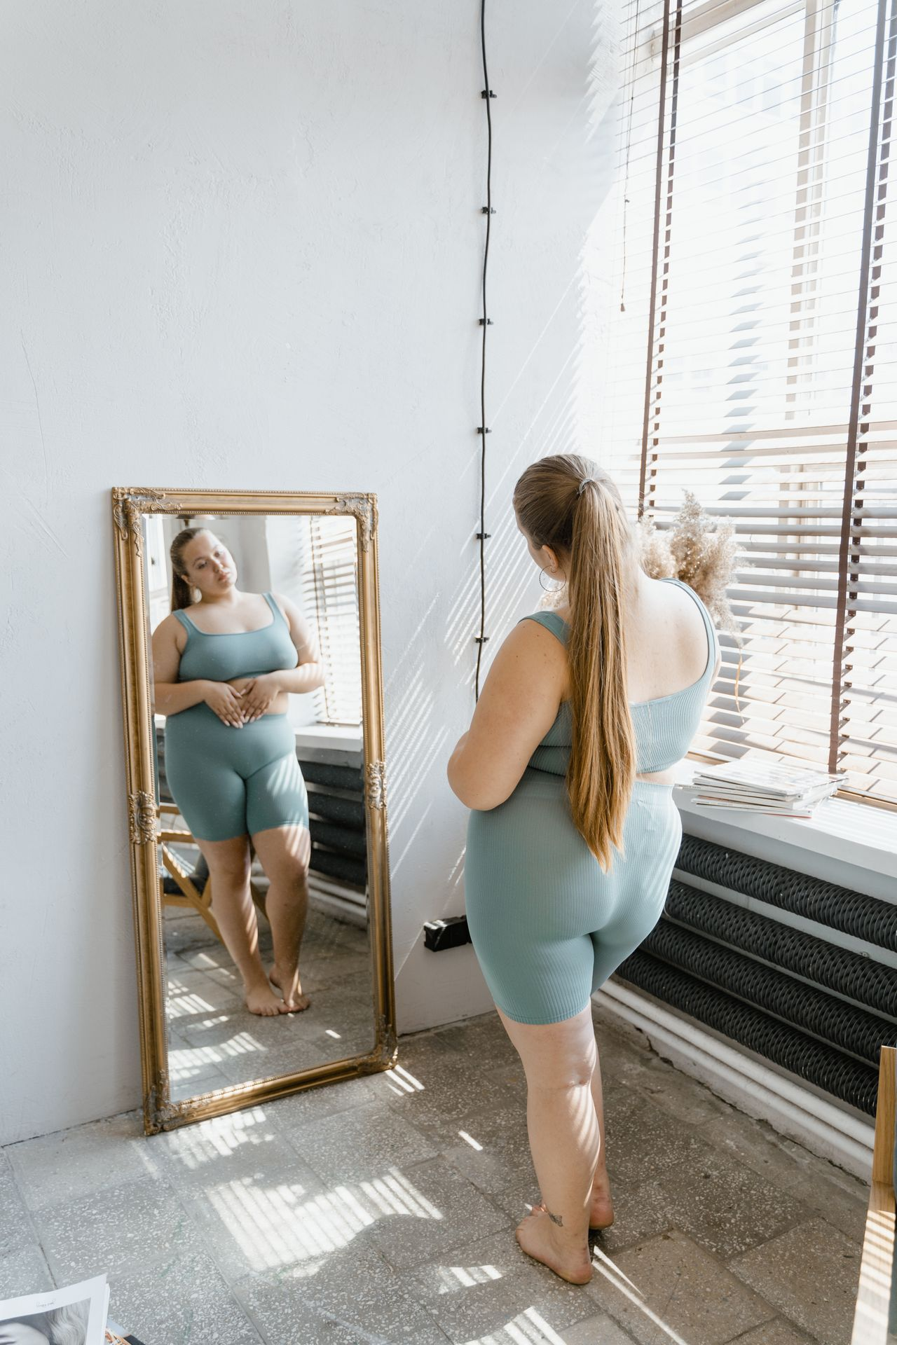
💪
Every Body Is Unique!
Bodies come in every shape and size — and all of them are normal.
There is no single "right" way to look. What makes you healthy is different from what makes you look a certain way.
Together For Health

Slide 3
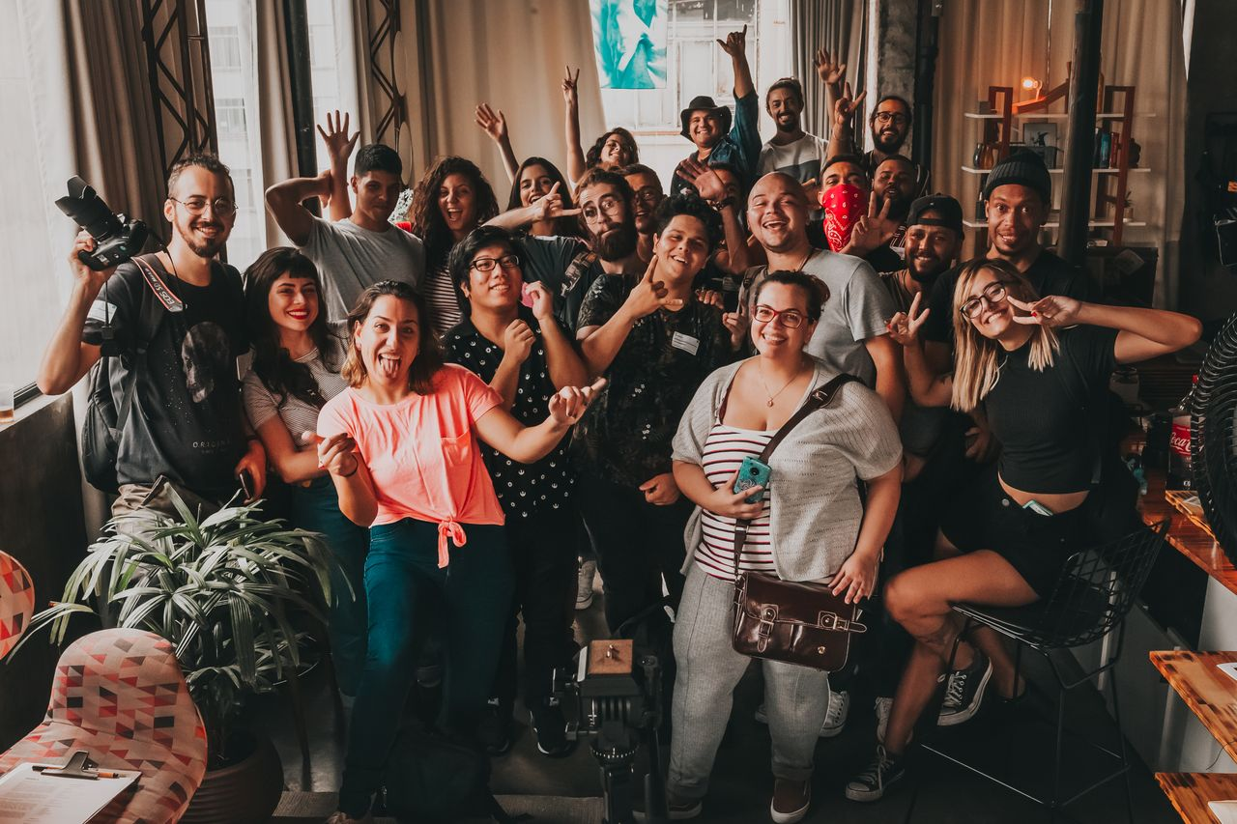
🌈
What Is Body Image?
Body image is how you think and feel about your own body
It is NOT about how your body actually looks
Positive body image = feeling comfortable in your own skin
Negative body image = feeling bad or embarrassed about your body
Body image can change from day to day
Together For Health

Slide 4
📺
Where Body Pressure Comes From
Social media and magazines only show a tiny range of bodies
Most photos of people are heavily edited and filtered
Advertising companies make money by making you feel bad about yourself
People of all sizes can be healthy
The "ideal body" has changed completely in every decade of history
Together For Health

Slide 5
💚
Building Positive Body Image
Focus on what your body can DO, not how it looks
1
Unfollow accounts that make you feel bad about yourself
2
Surround yourself with people who respect all bodies
3
Talk back to negative thoughts: "My body is strong and takes me everywhere"
4
Wear clothes that feel good and make you feel confident
5
Together For Health

Slide 6
KEY TAKEAWAYS
Every body is worthy of respect — including yours
✓
Healthy looks different for every person
✓
You are so much more than how your body looks
✓
Resources
Kids Help Phone: 1-800-668-6868
Body Brave: bodybrave.ca
Talk to a trusted adult if you feel very bad about your body
Together For Health

